Slide 1
CAES Dress Code
From 2020-2021 Student Handbook

Slide 2
Allowed Shirts
Any solid color short or long sleeve polo

Slide 3
Allowed Pants and Shorts
Khaki or Navy
Plain front Chino /Twill

Slide 4
Not Allowed Pants and Shorts
No cargo, skinny or overly baggy

Slide 5
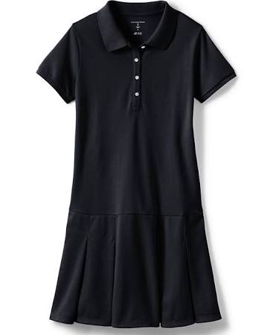
Allowed Skorts and Dresses
Khaki or Navy
To the Knee in length

Slide 6
Not Allowed Skorts and Dresses
Not above the knee, and not skinny

